Slide 1
Analytics for Unstructured Data Image Analytics Topic Modeling MSBA, F2021, 23rd September
Dr. Anitesh Barua
David Bruton Jr. Centennial Chair Professor of Business
Distinguished Fellow, INFORMS Information Systems Society
Stevens Piper Foundation Professor
University of Texas Distinguished Teaching Professor
Associate Director, Center for Research in e-Commerce
McCombs School of Business, University of Texas at Austin
Email: aniteshb@gmail.com

Slide 2
Meeting on 09/28 to discuss project ideas
10 mins per group
Sign up through googledocs (to be shared)
Come up with 2-3 ideas
Be prepared to discuss
What is the problem?
Why is it important?
Where is the data?
What type of analysis will you perform?
What do you expect in terms of results?

Slide 3
Image Analytics (Theory of CNN to be Covered Later)
Images (and videos) contribute much more to big data than text (or numbers)
> 3.5B images posted per day on social media
> 80% have no text attached
Not just social media: Medical images in healthcare, industrial applications
Can provide additional insights

Slide 4

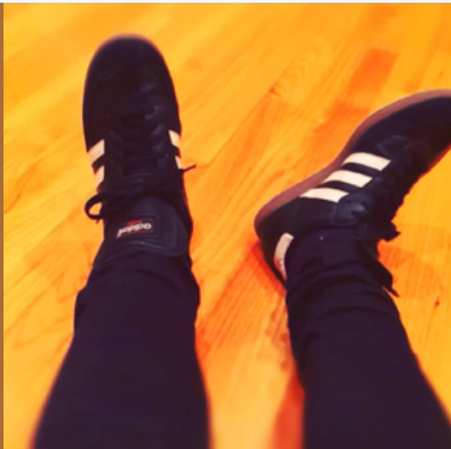

What Does an Image Reveal?
Dubai you will be missed.
Thank you for the inspiration
and the reset. Back to work now. 💙🌺
Post by Skrillex

Slide 5
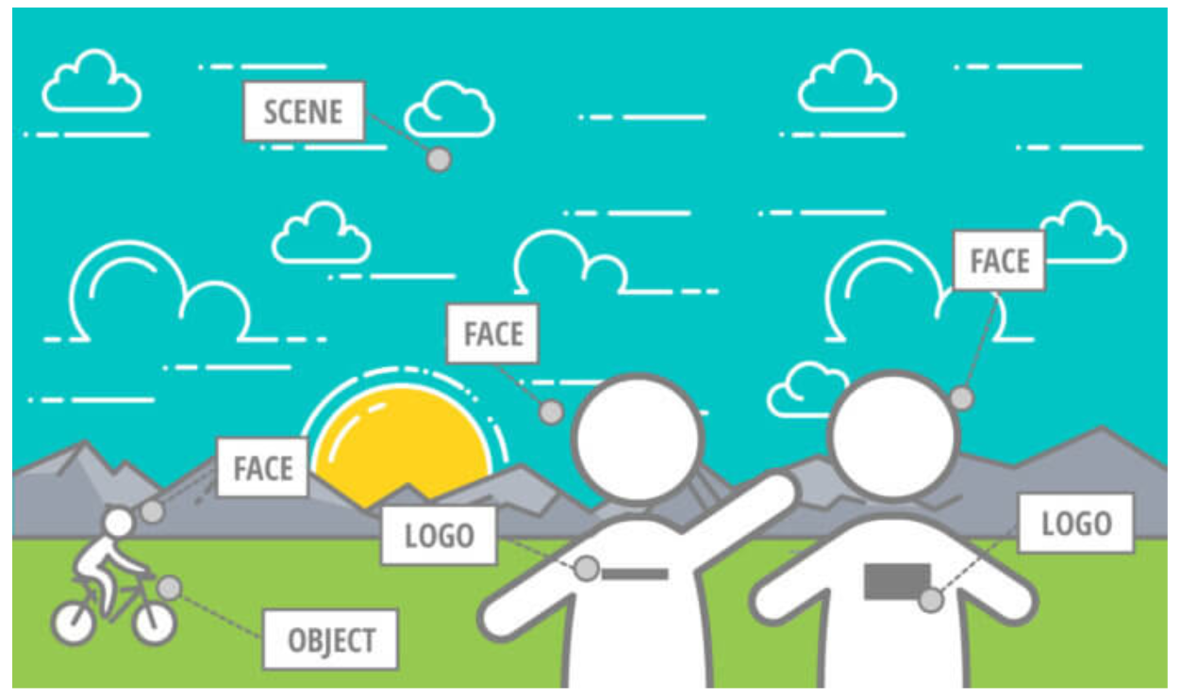
Many Elements

Slide 6
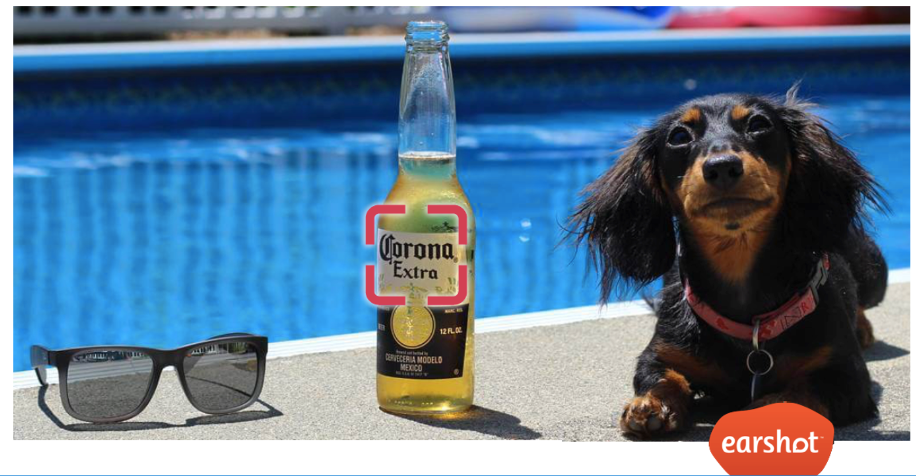
Moments of “Truth”

Slide 7
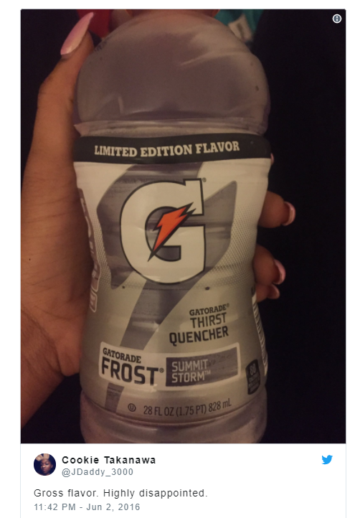

Whole > Sum of Parts?

Slide 8
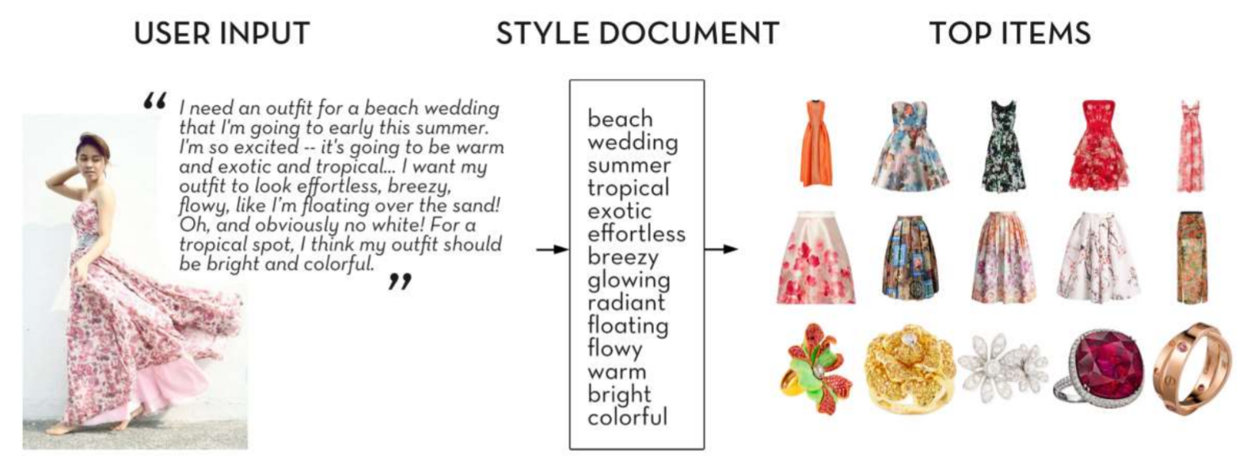
Combining Insights from Text & Images
Source K. Yamaguchi, 2017

Slide 9
Topic Modeling (Theory to be Covered Later)
What are the topics in these documents?
“I like to eat broccoli and bananas.”
“I ate a banana and spinach smoothie for breakfast.”
“Chinchillas and kittens are cute.”
“My sister adopted a kitten yesterday.”
“Look at this cute hamster munching on a piece of broccoli.”
Latent Dirichlet Allocation (LDA): a way of automatically discovering topics that these sentences contain
Topics and their distributions are “latent”
Source: E. Chen

Slide 10
The Key Ideas
Topics and words
Topic A: 30% broccoli, 15% bananas, 10% breakfast, 10% munching, …
Topic B: 20% chinchillas, 20% kittens, 20% cute, 15% hamster, …
Documents and topics
Documents 1 and 2: 100% Topic A
Documents 3 and 4: 100% Topic B
Document 5: 60% Topic A, 40% Topic B
Source: E. Chen

Slide 11
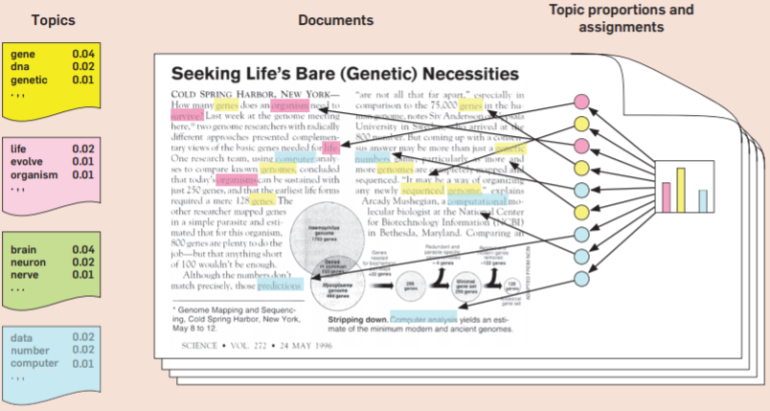
A Simple Generative Model
Source: D. Blei

